Slide 1
Cybersecurity Portal for Effective Management of Servers and Firewalls
PIP4004 Project
Review-1
Batch Number: CCS-G11
Roll Number | Student Name
20211CCS0103 | Gautham C N
20211CCS0109 | Jyotsna Banakar
20211CCS0052 | Vaibhav B Bharadwaj
Under the Supervision of,
Ms.Sterlin Minish T N
School of Computer Science and Engineering
Presidency University
Name of the Program: B-tech
Name of the HoD: Dr. Anandaraj S P
Name of the Program Project Coordinator: Dr. Sharmasth Vali Y
Name of the School Project Coordinators: Dr. Sampath A K / Dr. Abdul Khadar A / Mr. Md Ziaur Rahman

Slide 2
Introduction
Organization: AICTE
Category: Software
Problem Description:
The All India Council for Technical Education (AICTE) is responsible for managing and safeguarding critical infrastructure and data related to technical education institutions across India. To ensure robust cybersecurity measures, AICTE requires a centralized and comprehensive portal dedicated to managing servers, firewalls, load balancers, software licenses, user access, and other data center hardware components is commonly known as a Data Center Management Portal or Data Center Infrastructure Management (DCIM) Portal. However, the current infrastructure management practices face various challenges that hinder efficient and secure operations. The existing problem can be defined by the following factors: Fragmented Infrastructure Management: AICTE's infrastructure management practices may be fragmented, resulting in disparate systems and tools for managing servers, firewalls, load balancers, and other hardware components. This lack of centralized control leads to inefficiencies, inconsistencies, and potential security vulnerabilities. 1. Manual and Time-Consuming Processes: The absence of an integrated portal leads to manual and time-consuming processes for managing various infrastructure components. Activities such as provisioning, monitoring, patching, and license management are often performed manually, consuming significant human resources and increasing the risk of errors or oversights. 2. Limited Visibility and Control: Without a dedicated portal, AICTE may face challenges in gaining comprehensive visibility into the status, performance, and security of servers, firewalls, load balancers, and other hardware components. This limitation hampers effective monitoring, maintenance, and proactive identification of potential security threats or vulnerabilities. 3. Compliance and License Management: The absence of a centralized portal makes it difficult to track and manage software licenses and ensure compliance with licensing agreements. This may result in the misuse of licenses, unintentional non-compliance, or unnecessary expenses due to duplicate purchases or inadequate license usage tracking. 4. User Access Management: AICTE needs an efficient mechanism to manage user access to various infrastructure components. This includes defining user roles and permissions, ensuring secure authentication and authorization mechanisms, and maintaining an auditable log of user activities. Without a dedicated portal, managing user access becomes challenging and increases the risk of unauthorized access or privilege abuse. Addressing these challenges and implementing an AICTE Cybersecurity Portal has these specific feature need to be developed 5. Server Management: The portal allows administrators to manage servers, including provisioning, configuration, monitoring, and maintenance tasks. It provides an overview of server health, resource utilization, and performance metrics. 6. Firewall and Network Device Management: The portal enables management and configuration+F172F174 audit logs, and encryption of sensitive data. A well-designed Data Center Management Portal helps streamline operations, improve efficiency, and enhance the overall management of data center infrastructure and resources. It centralizes critical functions and provides a holistic view of the data center environment, enabling administrators to efficiently manage and monitor hardware components, network devices, user access, and software licenses.
Difficulty Level: Simple

Slide 3
Literature Review
DCIM Importance: Centralized Data Center Infrastructure Management (DCIM) improves visibility, compliance, and automation, addressing server and firewall management challenges.
AICTE’s Issue: AICTE’s current system lacks integration, making cybersecurity measures less effective
Cybersecurity Frameworks: Frameworks like NIST and ISO 27001 help organizations improve compliance and risk mitigation.
AICTE Vulnerability: Without a real-time security framework, AICTE is vulnerable to cyber threats and inefficiencies.
Machine Learning in Security: Deep learning-based intrusion detection improves threat detection accuracy by 85%, enabling faster threat identification.
Role-Based Access Control (RBAC): RBAC reduces security breaches by 60% and enhances access control.
Authentication Strengthening: Implementing JWT authentication and multi-factor authentication in AICTE's portal can prevent unauthorized access and privilege escalation.

Slide 4
Existing method Drawback
Manual Processes: The current system requires manual configuration and monitoring of servers and firewalls, which is slow and prone to human error.
Limited Visibility: Without a centralized portal, administrators have difficulty monitoring server health, firewall rules, and security threats in real time, leading to delayed detection and inefficient use of resources.
Compliance Issues: The lack of an automated license tracking system causes difficulty in ensuring compliance with software licenses, risking penalties and unnecessary costs.
Weak Access Management: The system lacks robust Role-Based Access Control (RBAC), increasing the risk of unauthorized access and insider threats.
Firewall Misconfigurations: Firewall policies are manually updated, causing misconfigurations and leaving the system vulnerable to cyber threats.

Slide 5
Proposed Method
The proposed method for our project will focus on developing a centralized cybersecurity portal that integrates automation, AI-driven threat detection, and secure infrastructure management to enhance server, firewall, and user access security .
Our main objectives are:
- Provide real-time security monitoring
- Automate firewall and server management
- Enable advanced data visualization for security analytics
- Integrate machine learning models for anomaly detection
- Enhance compliance tracking and user access management
Our project aims to overcome the drawbacks of existing systems and improve cybersecurity efficiency by leveraging automation, AI-driven security solutions, and advanced threat detection techniques .

Slide 6
Objectives
Develop a centralized cybersecurity portal for managing servers, firewalls, and network security.
Implement real time security monitoring to detect and respond to threats efficiently.
Automate firewall rule management to reduce human errors and enhance security configurations.
Enable role based access control (RBAC) and multi factor authentication (MFA) for secure user management.
Utilize machine learning models for anomaly detection and intrusion prevention .
Enhance compliance tracking and automated software license management .
Integrate data visualization tools for security analytics and system health monitoring.
Ensure scalability and cloud integration for future expansion and seamless operations.

Slide 7
Methodology/Modules
The methodology for our project will follow a structured approach with key phases:
Users Access the Portal (Admin, IT Security Team, Operators)
Authentication Layer (OAuth 2.0, JWT, MFA, RBAC)
Server & Firewall Management Module
Threat Detection & Intrusion Prevention (AI & ML Models)
Compliance & Security Log Storage (Database & SIEM Integration)
Data Visualization & Dashboard Generation

Slide 8
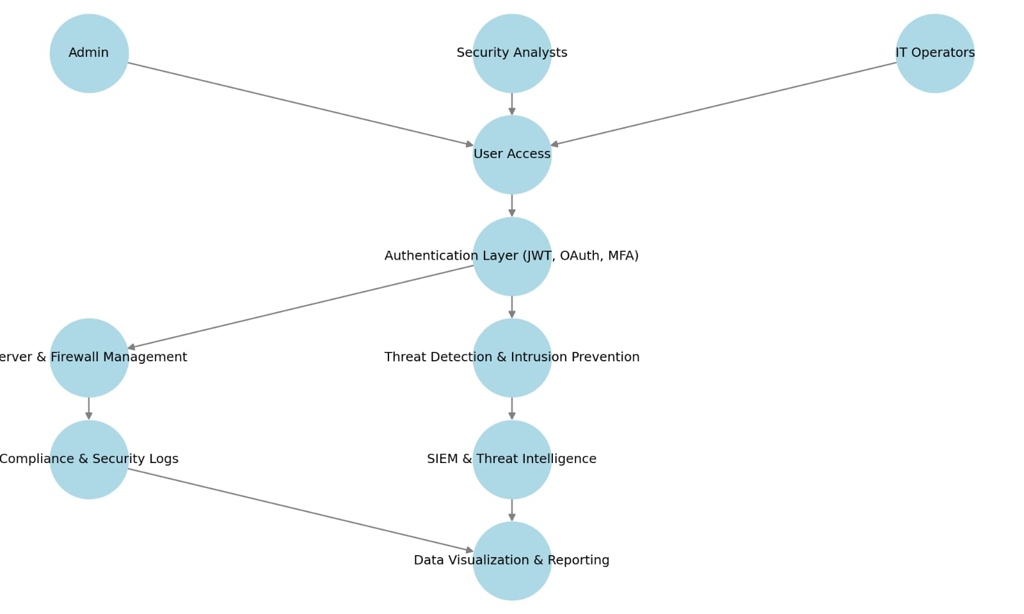
Architecture

Slide 9
Hardware/software components
Hardware Components
Server with Intel Xeon / AMD EPYC (8+ cores)
16GB+ RAM
SSD Storage (512GB+ recommended)
1 Gbps Network Interface
Firewall Appliance (Cisco ASA / Fortinet / Palo Alto)
Load Balancer (Nginx / HAProxy)
Intrusion Detection System (Snort / Suricata)
Software Components
Operating System: Linux (Ubuntu 20.04+ / CentOS 8)
Backend Framework: Flask (Python)
Frontend Framework: React.js
Database: PostgreSQL / SQLite
Authentication: JWT, OAuth 2.0, Multi Factor Authentication (MFA)
Firewall Management: iptables, firewalld
Intrusion Detection: OSSEC, Snort
Threat Intelligence: ELK Stack (Elasticsearch, Logstash, Kibana)
Data Visualization: Grafana, Kibana, D3.js
Compliance & Logging: SIEM Tools, Audit Logs

Slide 10
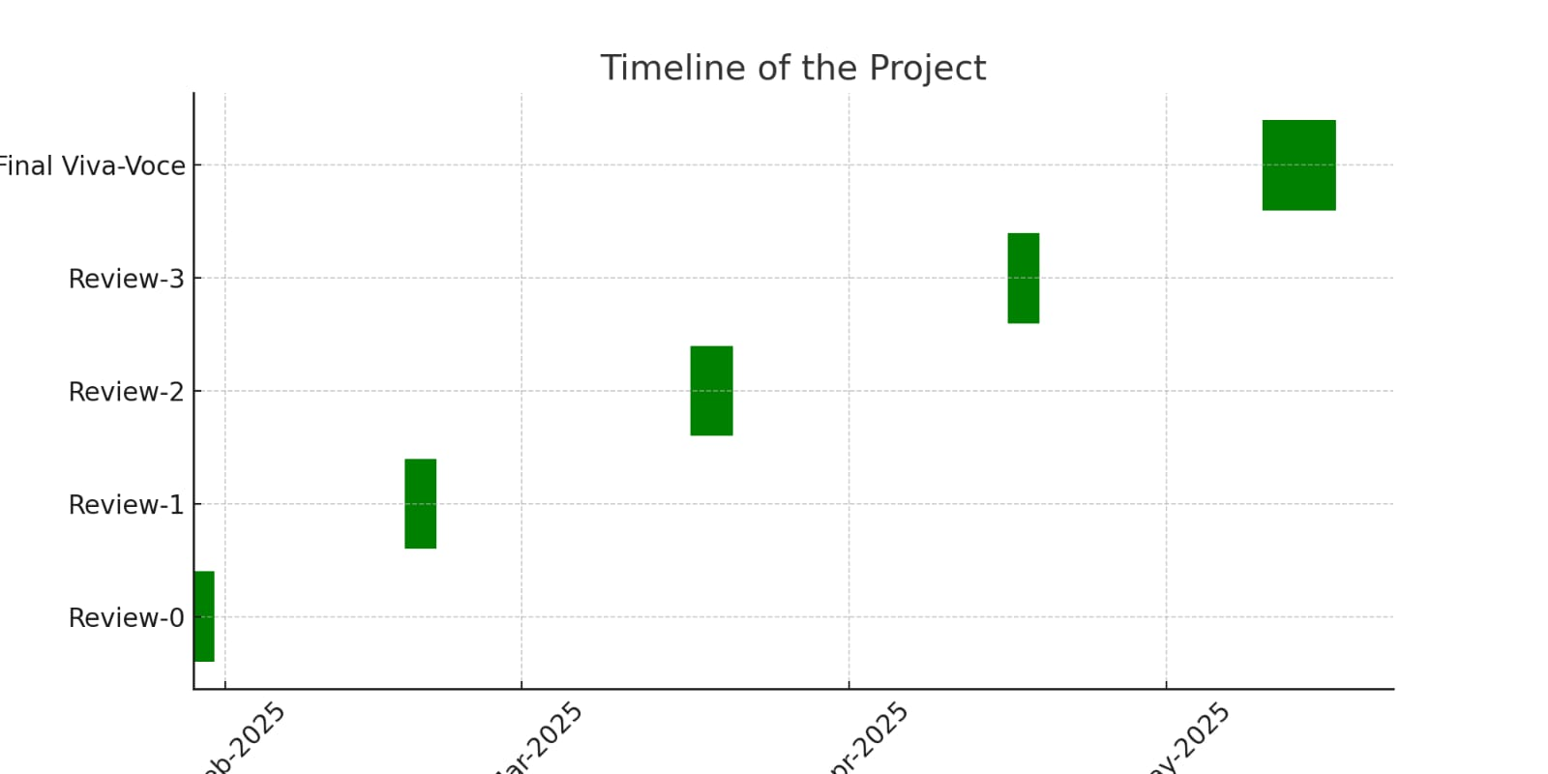
Timeline of Project

Slide 11
Expected Outcomes
Enhanced Cybersecurity – The AICTE Cybersecurity Portal will improve network and infrastructure security by integrating automated threat detection, firewall management, and intrusion prevention systems .
Real Time Threat Monitoring – The system will provide continuous monitoring of server health, firewall rules, and network security to detect potential security breaches and anomalies .
Automated Firewall and Server Management – The implementation of AI driven firewall rule management will reduce manual errors and optimize security configurations .
Compliance and Regulatory Adherence – The portal will help in tracking software licenses, generating audit logs, and maintaining compliance with standards like ISO 27001 and NIST Cybersecurity Framework .
Scalability and Cloud Integration – The architecture will support on premise and cloud based deployments , ensuring future scalability and flexibility for expanding AICTE’s infrastructure .
Data Visualization and Reporting – Security dashboards and analytics tools will provide detailed insights into system performance, security incidents, and compliance tracking .
Efficient Incident Response Mechanism – The system will enable real time alerts and automated responses to cyber threats and security breaches .

Slide 12
Conclusion
The AICTE Cybersecurity Portal will provide a centralized and automated system for managing servers, firewalls, user access, and compliance .
Real time security monitoring will enhance threat detection and response capabilities.
AI driven firewall and intrusion prevention systems will reduce manual errors and improve network security .
Role Based Access Control (RBAC) and Multi Factor Authentication (MFA) will ensure secure user access management .
Automated compliance tracking will help in maintaining ISO 27001 and NIST regulatory standards .
Machine learning based anomaly detection will improve threat intelligence and proactive security measures .
Scalability and cloud integration will allow future expansion and flexibility for AICTE’s growing infrastructure needs.
Security dashboards and automated reporting tools will provide better visibility into system performance and security incidents .

Slide 13
Github Link
https://github.com/JyotsnaBanakar1/Cybersecurity-Portal-for-Effective-Management-of-Servers-and-Firewalls

Slide 14
References
Mark Harris, "Data Center Infrastructure Management," in Data Center Handbook , Wiley, 2015, pp.601-618, doi: 10.1002/9781118937563.ch33. keywords: {Data centers;Business;Costs;Capacity planning;Asset management;Technological innovation;Standards organizations},
S. Qi, Y. Zhang and M. Wang, "Study and Application on Data Center Infrastructure Management System Based on Artificial Intelligence (AI) and Big Data Technology," 2019 IEEE 4th International Future Energy Electronics Conference (IFEEC), Singapore, 2019, pp. 1-4, doi: 10.1109/IFEEC47410.2019.9014987. keywords: {Data centers;Power demand;Artificial intelligence;Big Data;Monitoring;Maintenance engineering;Temperature distribution;Data center;AI;Big Data;energy saving},
M. Levy and J. O. Hallstrom, "A new approach to data center infrastructure monitoring and management (DCIMM)," 2017 IEEE 7th Annual Computing and Communication Workshop and Conference (CCWC), Las Vegas, NV, USA, 2017, pp. 1-6, doi: 10.1109/CCWC.2017.7868412. keywords: {Monitoring;Temperature sensors;Temperature measurement;Real-time systems;Humidity;Wireless sensor networks;Data centers;DCIM;infrastructure monitoring;efficiency;IoT;Internet of Things;wireless sensors;sensing;management},
Brown, A., & White, M. (2022). Machine learning algorithms for cyber threat detection: A review. IEEE Transactions on Cybersecurity, 14(1), 78-89. https://doi.org/10.1109/TCS.2022.3157123
Johnson, D., & Nguyen, L. (2023). Leveraging MISP for advanced threat intelligence sharing. Cybersecurity Analytics Review, 18(3), 102-115. https://doi.org/10.1109/CAR.2023.3198761
Koster, R., & McLeod, J. (2021). Collaborative threat intelligence: Techniques and challenges. Journal of Information Security, 12(4), 345-362. https://doi.org/10.1007/s10207-021-00567-8

Slide 15

Project work mapping with SDG

Slide 16
Thank You

